Slide 1


Personality Development
Dr.M.P.Ganesh
Department of Liberal Arts
IIT Hyderabad

Slide 2
What/why is this course??
A course on Self-understanding and Self-improvement
Transitioning from adolescence to young adulthood
Social and psychological independence
Choices and their consequences

Slide 3
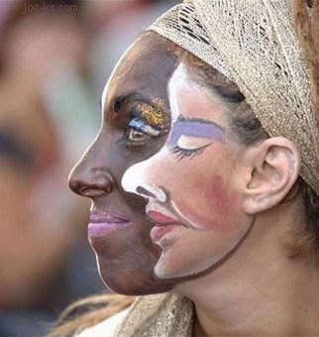
Who Am I??

Slide 4
Questions to ponder
Why do we behave the way we do?
Am I unique?
Is change possible?

Slide 5
Defining personality
Relatively stable characteristics of an individual which influences his/her behavior, attitudes, motivations and emotions.
Personality traits and types.

Slide 6
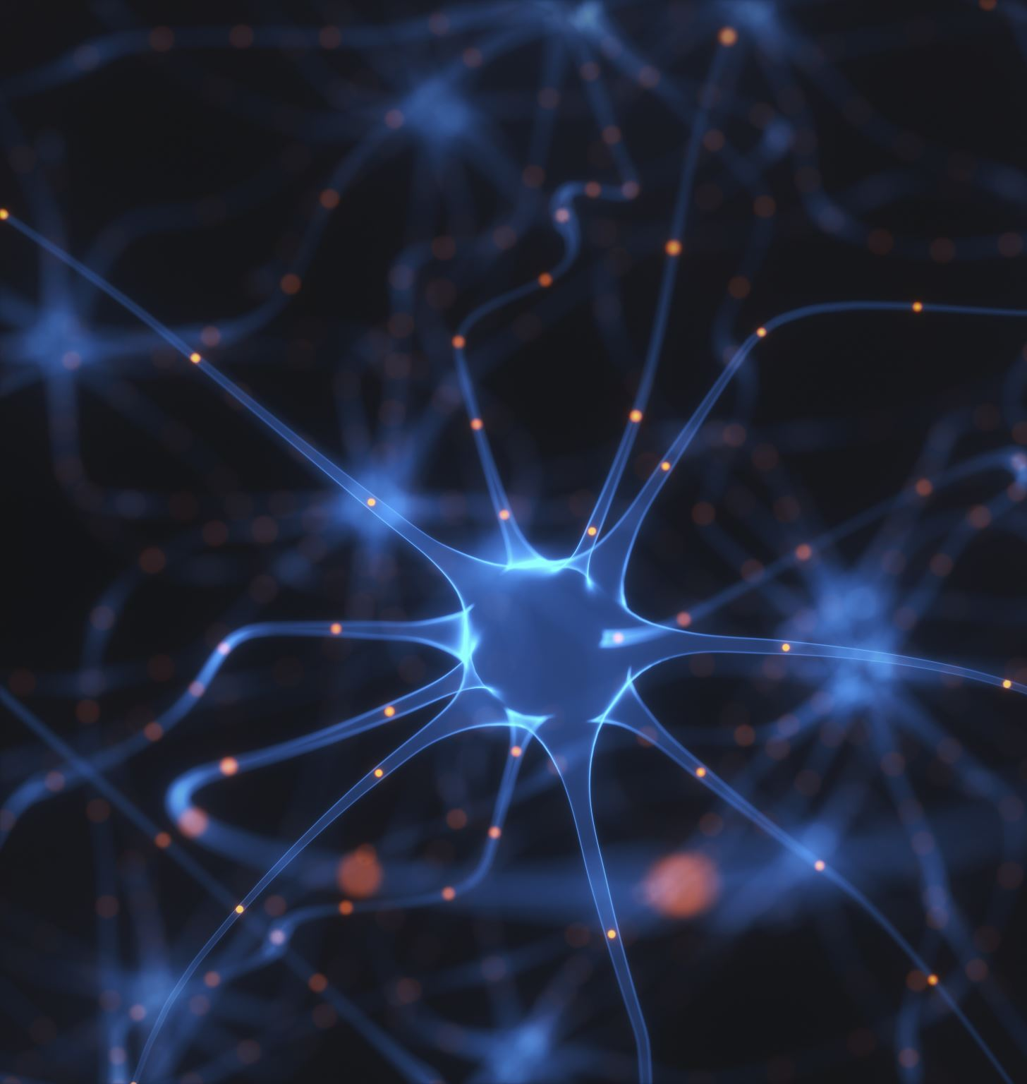
Biological determinants
The heredity
Brain functions
Physical features

Slide 7
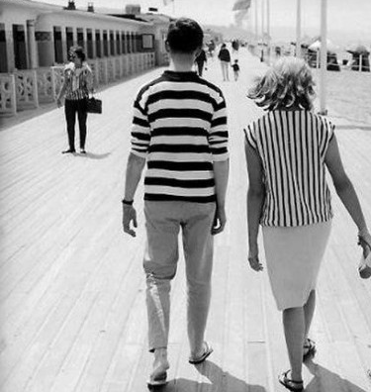
Genetic traits

Slide 8
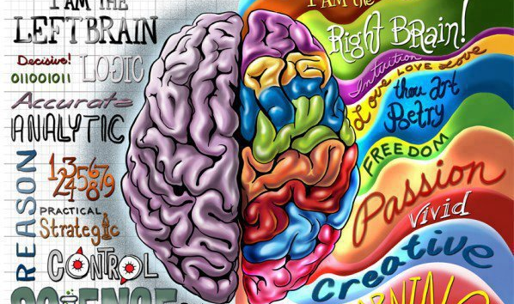
Left brain vs. right brain dominance

Slide 9
Cultural factors
Cultural norms
Culture specific behaviours
Cultural characteristics

Slide 10
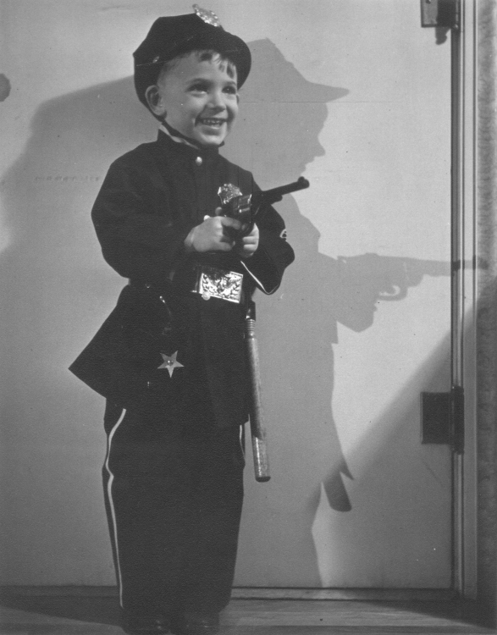
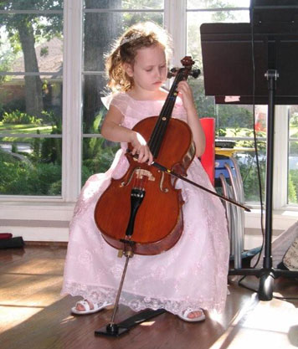
Upbringing

Slide 11
Family and social factors
Early childhood experiences
Role of significant others
Socialization
Identification process

Slide 12
Some theories
Freudian Theory - Role of Unconscious
Social learning
Self-Theory - The idea of “Self”

Slide 13
Intrapsychic theory
Sigmund Freud and psychoanalytic theory
Levels of consciousness
Conscious
Subconscious
Unconscious
Three elements of mind
Id, Ego and the Super Ego
Development of personality

Slide 14
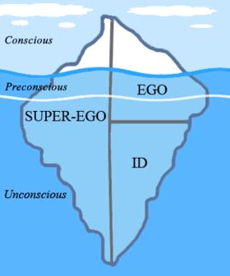
The tip of the iceberg

Slide 15
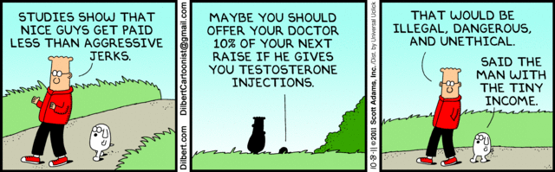
Aggression and competitiveness

Slide 16
Social learning theory
Learning is relatively permanent change in behaviour.
All behaviours are learned.
Impact of role-models in childhood.
Positive and negative reinforcements.
Internalized rewards.

Slide 17
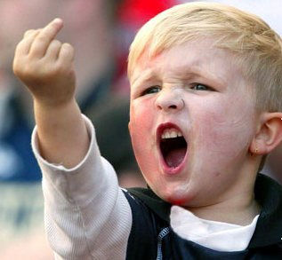
Vicarious learning

Slide 18
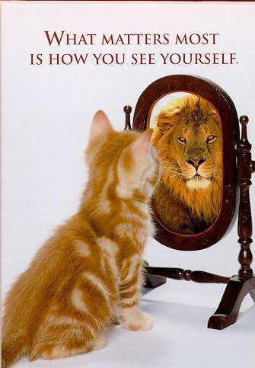

Slide 19
Self theory
Carl Rogers
Free will
Self-concept
The organism
Self-esteem
The development of self
Unconditional acceptance

Slide 20
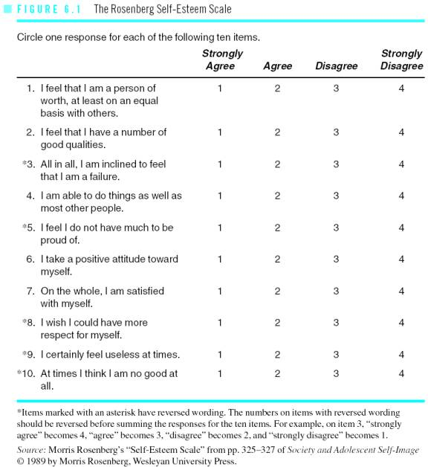

Slide 21
Individuals with high self-esteem
Happy and satisfied
Realistic expectations
Realistic understanding of self
Moderate risk takers
Friendly and encouraging
Highly motivated
Self-disciplined
Ready to take responsibilities

Slide 22
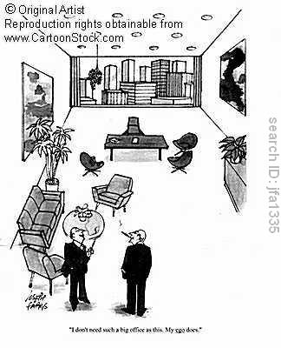
I don’t need such a big office as this, my ego does

Slide 23
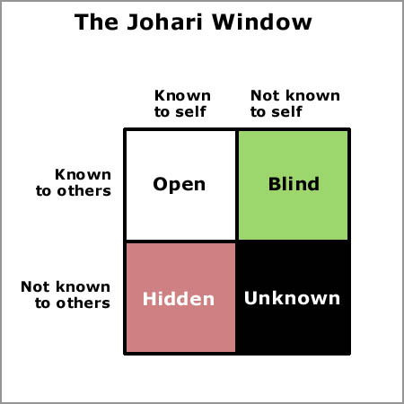
Self-Awareness

Slide 24
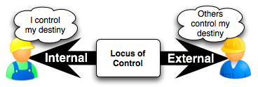
Locus of control

